Slide 1
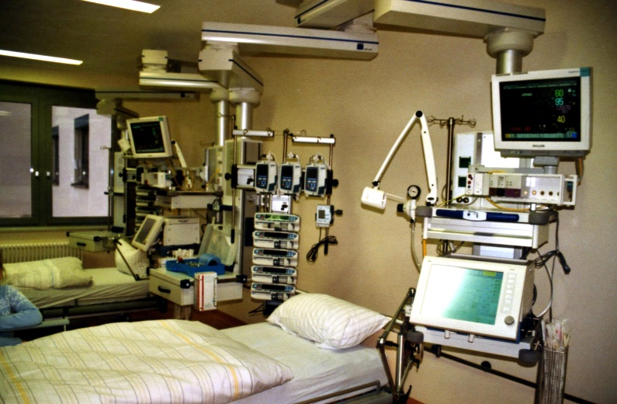


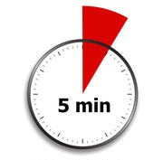
Team 10: Danilo, Tristan, Matthias, Phileas
Quality of care in the ICU during nighttime
January 20-21, 2018

Slide 2
Introduction
ICU is supposed to maintain the quality of care in a 24 / 7 manner, but this may not be the case
Glucose control is a surrogate of quality of care
The null hypothesis is that glucose levels are independently stable over time (day vs. nighttime)
Aim
Identify any differences in glucose control between daytime and nighttime
Apply Machine Learning techniques to differentiate daytime vs. nighttime, using glucose measurements

Slide 3
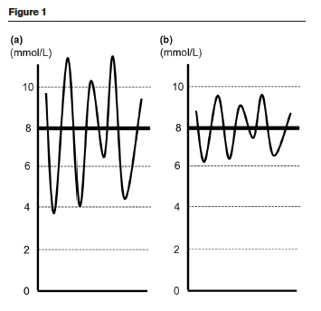

Slide 4
Table 2. Glucose measurements
 | Total | Daytime Empirical CI 5%-95% | Nighttime Empirical CI 5%-95% | Reject Null Hypothesis ?
Measurements nb | 417117 | 222987 | 194130
Glucose mean | 145.7 (55.3) | 143.1-144.4 | 146.7-148.0 | Yes
Low values (n, %) | 19666 (4.7) | 9746 (4.4) | 9320 (4.8)
High values (n, %) | 77824 (18.7) | 43755 (19.6) | 34069 (17.5)
Range in the period (10-90%) | 120 | 121-124 | 116-120 | Yes
SD of the period | 55.4 | 54.98-56.30 | 54.19-55.67 | No
logGLI of the period GLI was too penalizing for high variations | 2.59 | 2.46-2.55 | 2.73-2.82 | Yes

Slide 5
Machine learning modeling as a statistical test
 | Quality of fit | Interpretability
Generalized linear model (GLM) | Poor | Good
Gradient boosted model (GBM) | Good | Poor
We choose GBM, because we are more interested in the performance of the model than on the interpretation of the variables impact

Slide 6
Building the training set
One observation (unit of analysis) per night/day spend by a patient in ICU\
Variables used in our model are features derived from glucose measurements per period of observation
From measured value (SD, Range (10-90%), min, max, number of peaks above/below threshold)
From difference between consecutive measured values (SD, GLI, Range (10-90%), min, max)
From timegap between measurements (SD, Range (10-90%), min, max)
Filter when at least 3 measurements were made => 41711 units of analysis
Train and Test sets (70-30) are built on disjoint patients

Slide 7
Our results
AUC = 0.64 on test set (p-value<0.01)
So we have a model, can we interpret it and understand what are the key quality indicators ? Yes, using Relative Importance and Partial Dependency Plots
Max time interval between glucose measurements had the greatest impact : Explains 10% spread in probability Night/Day
Interpretation : night care is more protocolized and less reactive / adapted to patient specific requirements

Slide 8
Conclusion
Regarding glucose measurements (pattern of sample collection and results), daytime and nighttime are not equal

Slide 9
GBM is not a black box!
GBM has stronger predictive power
It’s enough interpretable
We could find a metric for level of adaptation to patient’s needs which accounts for 10% spread between day and nighttime.

